Slide 1
Web Mining Concepts and Applications
Utkarsh Sharma
Jaypee University of Engineering & Technology
India

Slide 2
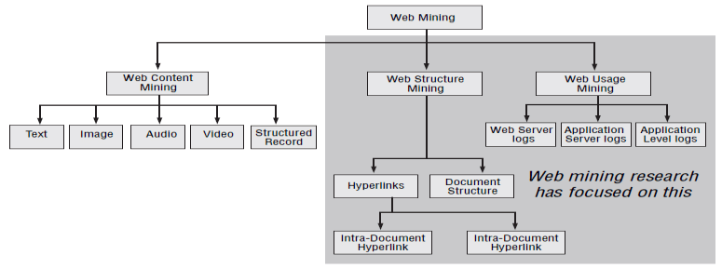
Introduction
Web mining is actually an area of data mining related to the information available on internet. It is a concept of extracting informative data available on web pages over the internet

Slide 3
Why Web Mining ??
Web data is
􀁺Web content –text, image, records, etc.
􀁺Web structure –hyperlinks, tags, etc.
􀁺Web usage –http logs, app server logs, etc.

Slide 4


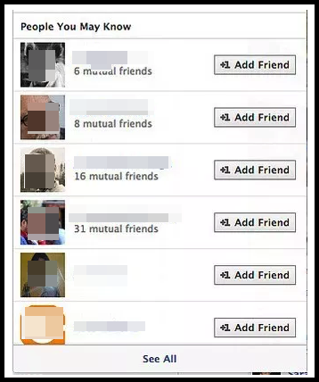
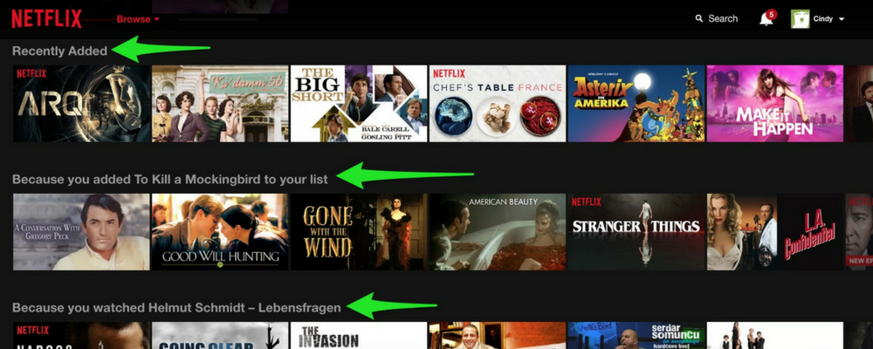
Application: Recommendation System

Slide 5
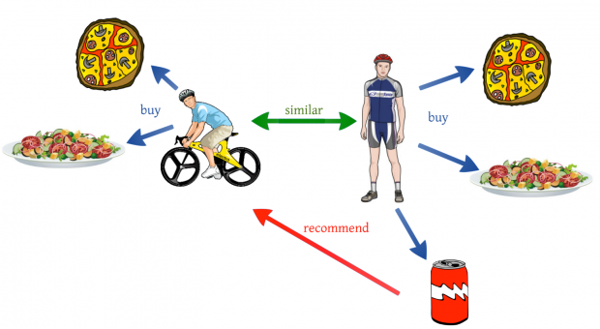
DIFFERENT TYPES OF RECOMMENDATION ENGINES
Collaborative Filtering

Slide 6
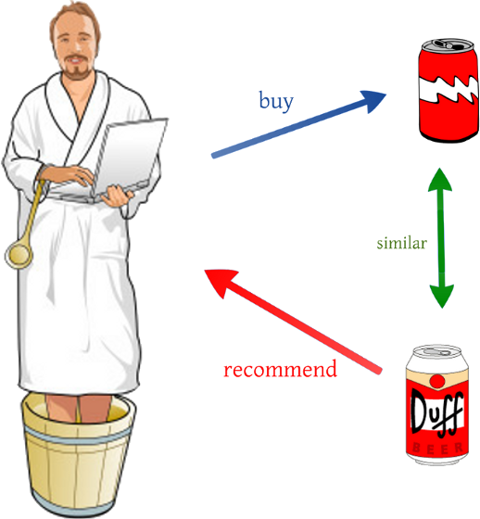
Content Based Filtering

Slide 7
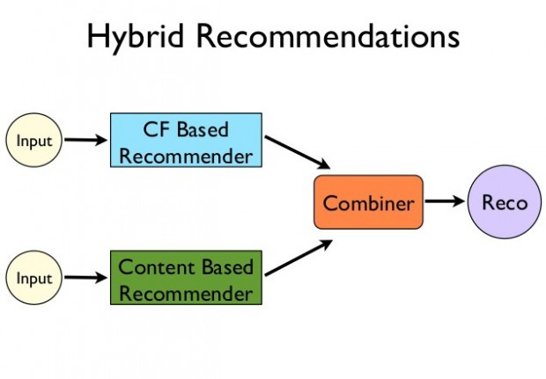

Slide 8
Web Content Mining

Slide 9
Definition
Web Content Mining is the process of extracting useful information from the contents of Web documents.
Content data corresponds to the collection of facts a Web page was designed to convey to the users.
Research activities in this field also involve using techniques from other disciplines such as Information Retrieval (IR) and natural language processing (NLP).

Slide 10



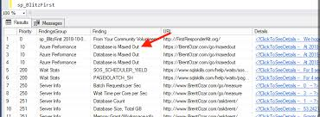
Web Content Mining
It may consist of:

Slide 11
Web Content Mining

Slide 12
Pre-processing Content
Content Preparation
Extract text from HTML.
Perform Stemming.
Remove Stop Words.
Calculate Collection Wide Word Frequencies (DF).
Calculate per Document Term Frequencies (TF).
Vector Creation
Common Information Retrieval Technique.
Each document (HTML page) is represented by a sparse vector of term weights.
TFIDF weighting is most common.
Typically, additional weight is given to terms appearing as keywords or in titles.

Slide 13
Common Mining Techniques
The more basic and popular data mining techniques include:
Classification
Clustering
Associations
The other significant ideas:
Topic Identification, tracking and drift analysis
Concept hierarchy creation
Relevance of content.

Slide 14
Web Content Mining Applications
Identify the topics represented by a Web Documents
Categorize Web Documents
Find Web Pages across different servers that are similar
Applications related to relevance
Queries –Enhance standard Query Relevance with User, Role, and/or Task Based Relevance
Recommendations –List of top “n” relevant documents in a collection or portion of a collection.
Filters –Show/Hide documents based on relevance score

Slide 15
Web Structure Mining

Slide 16
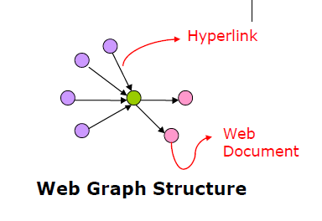
What is Web Structure Mining?
The structure of a typical Web graph consists of Web pages as nodes, and hyperlinks as edges connecting between two related pages
Web Structure Mining can be the process of discovering structure information from the Web
This type of mining can be performed either at the (intra-page) document level or at the (inter-page) hyperlink level
The research at the hyperlink level is also called Hyperlink Analysis

Slide 17
Motivation to study Hyperlink Structure
Hyperlinks serve two main purposes.
Pure Navigation.
Point to pages with authority* on the same topic of the page containing the link.
This can be used to retrieve useful information from the web.

Slide 18
Web Structure Terminology
Web-graph:A directed graph that represents the Web.
Node:Each Web page is a node of the Web-graph.
Link:Each hyperlink on the Web is a directed edge of the Web-graph.
In-degree:The in-degree of a node, p,is the number of distinct links that point to p.
Out-degree:The out-degree of a node, p, is the number of distinct links originating at pthat point to other nodes.

Slide 19
Web Structure Terminology(2)
Directed Path:A sequence of links, starting from p that can be followed to reach q.
Shortest Path:Of all the paths between nodes pand q,which has the shortest length, i.e. number of links on it.
Diameter:The maximum of all the shortest paths between a pair of nodes p and q, for all pairs of nodesp andqin the Web-graph.

Slide 20
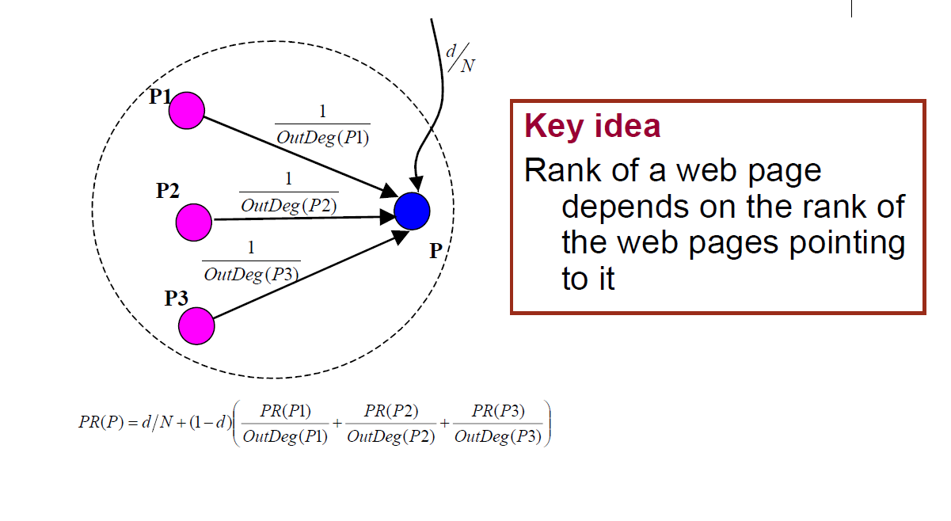
Google’s PageRank

Slide 21
Example
 | Iter 1 | Iter 2 | Iter 3 | Page Rank
A | ¼
B | ¼
C | ¼
D | ¼
 | Iter 1 | Iter 2 | Iter 3 | Page Rank
A | ¼ | 1/12 | 1.5/12 | 1
B | ¼ | 2.5/12 | 2/12 | 2
C | ¼ | 4.5/12 | 4.5/12 | 4
D | ¼ | 4/12 | 4/12 | 3
A
B
C
D
P(A)=(1/4)/3= 1/12
P(B)= (¼)/2 + (¼)/3 = 2.5/12
P(c)= (¼)/2 + ¼ = 4.5/12
P(D)= (¼) + (¼)/3 = 4/12

Slide 22
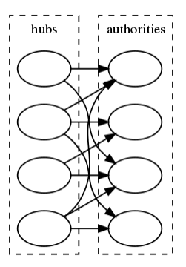
HITS Algorithm
Hypertext Induced Topics Search (HITS) developed by Jon Kleinberg.
HITS is applied on a subgraph after a search is done on the complete graph.
Uses hubs and authorities to define a recursive relationship between web pages.
An authority is a page that many hubs link to.
A hub is a page that links to many authorities

Slide 23
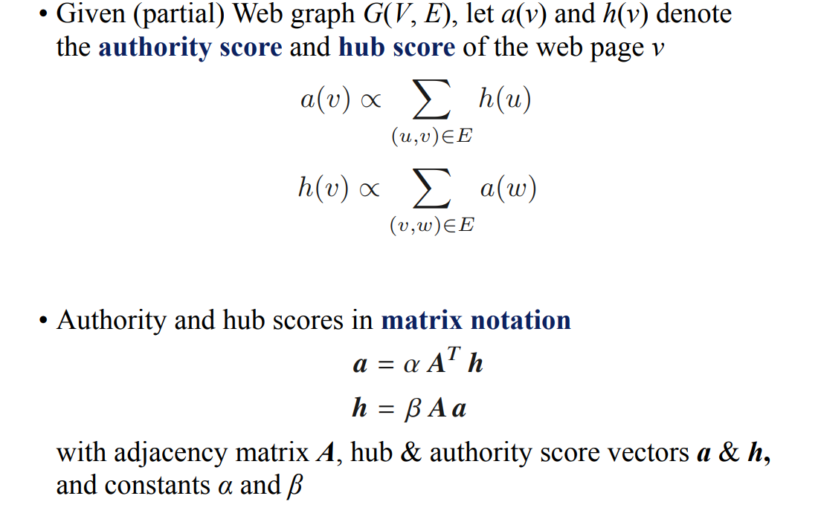
HITS Algorithm

Slide 24
Example
Find the hubs and authority scores for the given graph for K=3 and initial hub weight vector as 1.
N1
N2
Nodes | Out Degree(Hub) | In Degree(Authority)
N1 | 3 | 1
N2 | 2 | 1
N3 | 2 | 2
N4 | 1 | 4
N3
N4

Slide 25
Example
Adjacency Matrix A
 | N1 | N2 | N3 | N4
N1 | 0 | 1 | 1 | 1
N2 | 0 | 0 | 1 | 1
N3 | 1 | 0 | 0 | 1
N4 | 0 | 0 | 0 | 1
Transpose Matrix A
T
 | N1 | N2 | N3 | N4
N1 | 0 | 0 | 1 | 0
N2 | 1 | 0 | 0 | 0
N3 | 1 | 1 | 0 | 0
N4 | 1 | 1 | 1 | 1

Slide 26
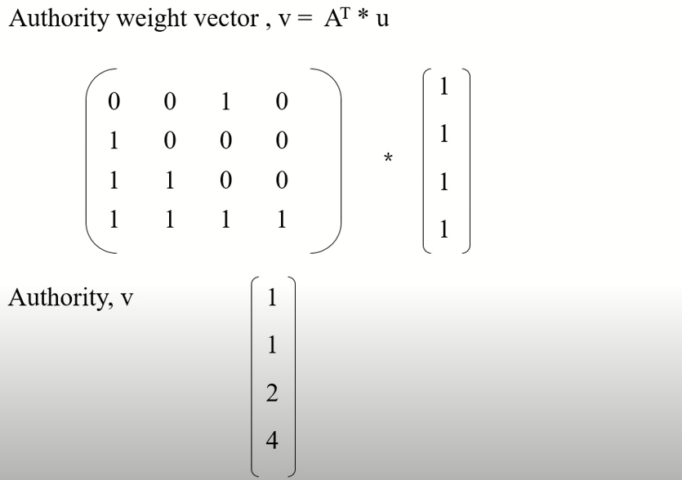
Example
Assuming initial Hub weight vector u as 1

Slide 27
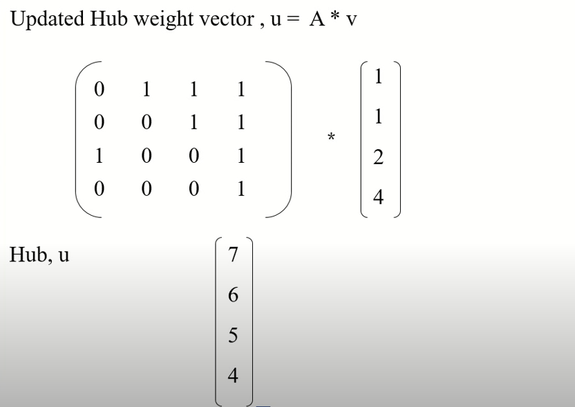
Example

Slide 28
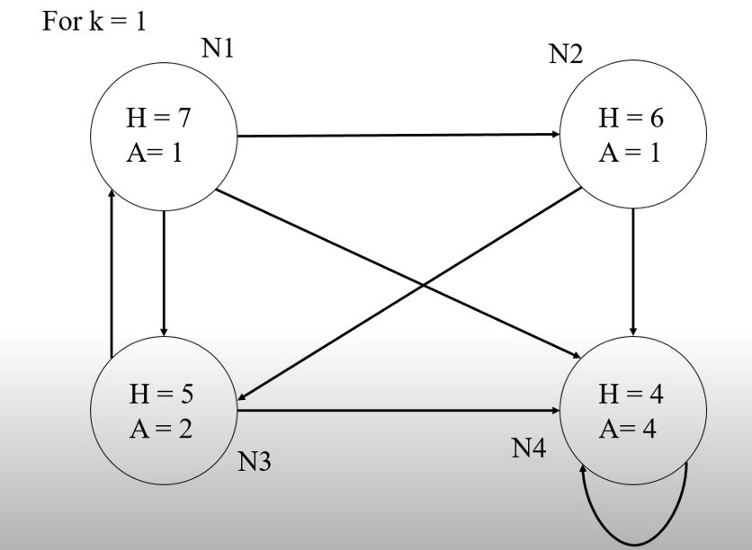
Example

Slide 29
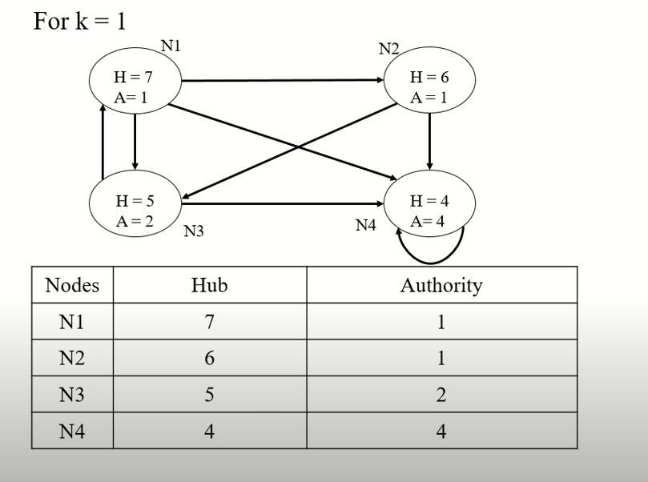
Example

Slide 30
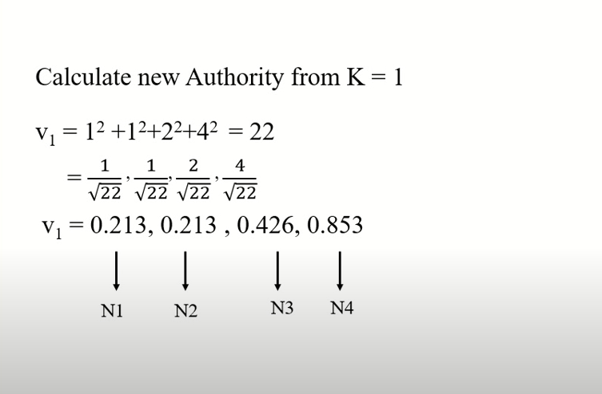

Example
2

Slide 31
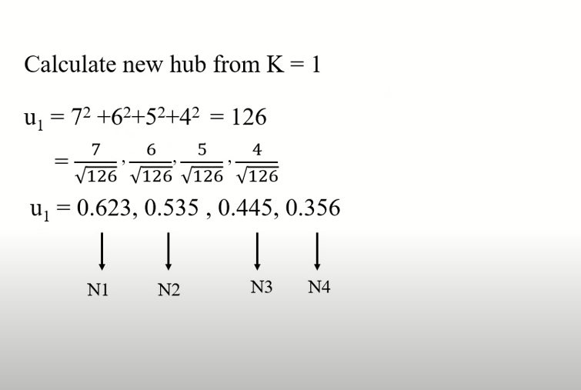
Example

Slide 32
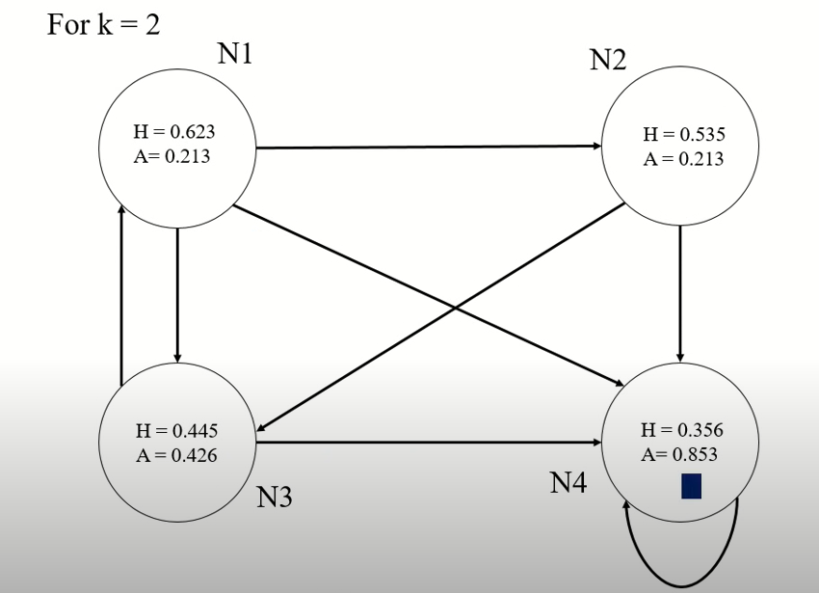
Example

Slide 33
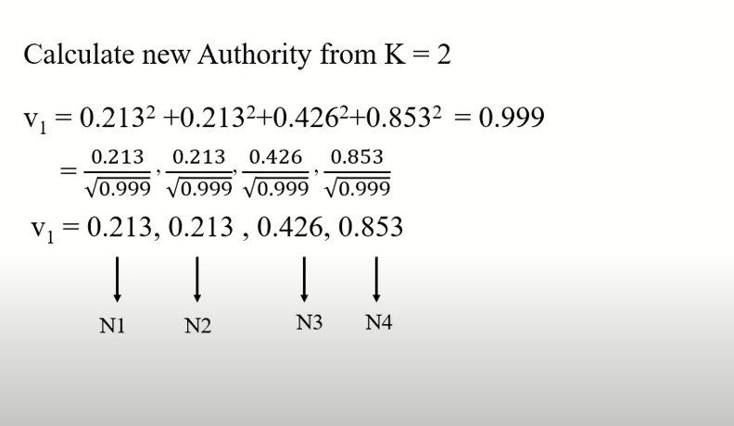
Example

Slide 34
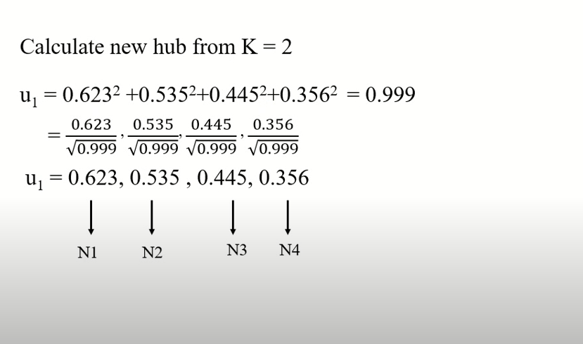
Example

Slide 35
Python Code for HITS
import networkx as nx
import matplotlib.pyplot as plt
G = nx.DiGarph()
G.add_edges_from([('A', 'D’), ('B', 'C'), ('B', 'E'), ('C', 'A'), ('D', 'C’), ('E', 'D'), ('E', 'B'), ('E', 'F'),('E', 'C’), ('F', 'C'), ('F', 'H'), ('G', 'A'), ('G', 'C'), ('H', 'A')])
plt.figure(figsize =(10, 10))
nx.draw_networkx(G, with_labels = True)
hubs, authorities = nx.hits(G, max_iter = 50, normalized = True)
print("Hub Scores: ", hubs)
print("Authority Scores: ", authorities)

Slide 36
Output
Hub Scores: {'A': 0.04642540386472174, 'D': 0.133660375232863,
'B': 0.15763599440595596, 'C': 0.037389132480584515,
'E': 0.2588144594158868, 'F': 0.15763599440595596,
'H': 0.037389132480584515, 'G': 0.17104950771344754}
Authority Scores: {'A': 0.10864044085687284, 'D': 0.13489685393050574,
'B': 0.11437974045401585, 'C': 0.3883728005172019,
'E': 0.06966521189369385, 'F': 0.11437974045401585,
'H': 0.06966521189369385, 'G': 0.0}

